Slide 1




Harmonizing Asynchronous Systems: NATS, CloudEvents, and AsyncAPI
Notes:
Welcome everyone! I am glad to be here and thank you for coming to my talk.
Today, I want to talk about how we can ”harmonize” Asynchronous Systems. We will look into a few of my favorite technologies that really help tackle the complexity of building, running and maintaining asynchronous systems. These are NATS, CloudEvents and AsyncaPI.

Slide 2
Hello!
I am Artur Ciocanu.
I am here today to talk about NATS, CloudEvents and AsyncAPI. Twitter/X: @artur_ciocanu LinkedIn: https://www.linkedin.com/in/artur-ciocanu/
GitHub: @artur-ciocanu
Notes:
Hello my name is Artur; I am Lead Senior Computer Scientist, currently working at Adobe. You can find my on the Internet using these handles.

Slide 3

Contents
Introduction
NATS
CloudEvents
AsyncAPI
Demo
Conclusion
Notes:
Here are the things that we will cover today. We will have a quick introduction, then we will briefly cover NATS, CloudEvents and AsyncAPI technology, and I hope to have time to go over the demo that I have prepared, so we could see all these technologies in action.

Slide 4

Introduction
Notes:
Asynchronous systems are notoriously difficult to build, run and maintain, without proper planning and at least some upfront design, things will get messy very quickly.

Slide 5

Notes:
We can think of these systems like highways during rush hour—there’s a lot of traffic, things need to keep moving and it is sufficient to have at least one glitch for the situation to from “bad” to “horrible”. But unlike our real-world traffic, with the right tools at our disposal, we can design these highways to be super-efficient!

Slide 6

Introduction
Harmony
Harmonizing
A state where different elements come together seamlessly, creating a sense of peace and unity
Blending different parts to create a cohesive and pleasing whole
Notes:
The title of the talk mentions “harmonizing”, so I think it is important to understand the definition of “harmony” and “harmonizing”. I really like the piece with “cohesive and pleasing whole”.
As engineers we forget that if something is pleasing most probably it will also be easier to understand.

Slide 7

Notes:
As humans we always use abstractions and metaphors to tackle complexity. For this talk I thought that I would use the Just In Time Delivery from the Supply Chain Management.
Just In Time Delivery originated as part of the Toyota Production System.

Slide 8



Introduction
NATS
CloudEvents
AsyncAPI
Notes:
In Just in Time Delivery, we have quite a few concepts, but for this talk we will focus on:
Transportation – this will be handled by NATS
Packaging – this will be handled by CloudEvents
Routes and routes planning – this will be handled by AsyncAPI
Now let’s dive into each component.

Slide 9
NATS
Notes:
NATS is CNCF project, that has been started over 10 years ago. It is written in Golang. It is a very robust pub/sub systems. It provides the primitives to build distributed systems of any complexity.
I like to think of NATS as set of axioms for distributed systems, similar to 5 axioms from Euclid “Elements” for geometry or for those familiar with Paul Graham essay “The Root of Lisp”, where the whole language is based on a set 7 primitives.

Slide 10

Notes:
For our Just In Time Delivery metaphor, I would like to think of NATS and this futuristic highspeed train that can deliver a package extremely fast anywhere.

Slide 11
NATS
NATS – transportation
Low latency and high performance.
Supports multiple messaging patterns (e.g., pub/sub, request/reply, work queue, streaming, etc).
Highly available with built-in resilience.
CNCF Incubating Project.
Notes:
Here is a quick recap of NATS:
Low latency
Supports multiple
Highly Available with built-in-resilience
NATS might be known as a messaging system, but it is much more than that. It is like a Connectivity Fabric, that can be used across your enterprise to connect both internal and external systems.
If you haven’t seen Derek Collison presentation called “Rethink Connectivity” I highly recommend it. Derek is NATS creator.

Slide 12
CloudEvents
Notes:
CloudEvents is a very small specification. One the reason that is so successful is that it focuses on providing essential metadata for activation, validation, transformation or routing.

Slide 13

Notes:
For our Just In Time Delivery metaphor the CloudEvents represent the boxes that can have different shape and size, and we do not necessarily care about the content, but we do care about the routing details and labels.

Slide 14
CloudEvents
CloudEvents –packaging
Lightweight, essential metadata.
Enhances interoperability between systems.
Supports various event-driven architectures.
Protocol agnostic
CNCF Graduated Project.
Notes:
CloudEvents specification has been build in collaboration with major tech companies including Amazon, Microsoft, Google, Adobe, etc.
Its focus is to provide essential metadata By design it doesn’t have all the bells and whistles, that you could find in other specifications. Anyone remember the good old days of various XML specifications ☺.

Slide 15

Notes:
Anyone can tell what is this?
Right, it is a jar of “jam”. Our industry is full of acronyms, so I decide to have one of my own ☺.

Slide 16
CloudEvents
Just Enough Metadata
specversion – CloudEvents specification version.
id – identifies the event.
source – identifies the context in which the event happened.
type – describes the type of the event.
Notes:
I like to think of CloudEvents as J. E. M. – Just Enough Metadata, the reason I am mentioning this is that we as engineers tend to add more and more to a specification, we always see use cases and things we can add.
But in engineering just like in cooking or art, we should find a balance and use “just enough”.
CloudEvents spec is starting to add other things like discovery, etc and I am not sure if this the right move.

Slide 17
AsyncAPI
Notes:
Finally, we get to AsyncAPI. AsyncAPI is a specification that is part of Linux Foundation. It tries to combine both things like request/reply that we have in OpenAPI as well as Event Driven APIs like Kafka, RabbitMQ, AWS SQS, Azure EventHub, etc

Slide 18

Notes:
For our Just In Time Delivery metaphor AsyncAPI is this super efficient route planner and routes descriptions, that knows how and when to send packages from point A to point B. Also it contains quite detailed data about the contents of the package.

Slide 19
AsyncAPI
AsyncAPI – route planner
Defines how messages are sent and received.
Ensures consistency across services.
Provides clear documentation for developers.
Provides various tooling for docs, code gen, etc
Joined Linux Foundation in 2021
Notes:
OpenAPI is probably the well known by the majority and it is used to describe REST APIs aka RPCs. AsyncAPI the other hand is not new by any stretch but is not well known and my hope that all of you will learn about it and spread the word ☺.
AsyncAPI has an ambitious goal to be able to describe both RPC style APIs as well Event Driven API. It has an awesome community and a myriad of tools for IDEs, documentation, code generation and much, much more.

Slide 20
Demo Setup
Notes:
Now that we are done with the theoretical part, let’s see all these technologies in action.

Slide 21
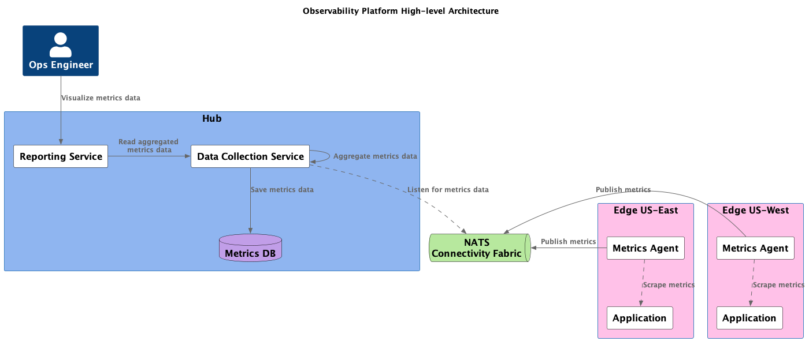
Notes:
This is a very simplified version of a fictional observability platform. The purpose of this is to demonstrate how we can use NATS, CloudEvents and AsyncAPI.
Most of you are probably sick and tired of eCommerce examples like order placed, order shipped, etc, so I decided to have something more ops oriented.
At a high level we have:
NATS – which acts a nervous system connecting all the pieces
Metrics Agents – that are collecting metrics data
Data Collection Service – responsible for data transformation, aggregation
Reporting Service – responsible for presenting the aggregated metrics
Visualization – this is a simple Web page that presents the metrics in a nice dashboard
Let’s see how all this works together.

Slide 22
Conclusion
Notes:
As you can see having the right technologies, we can make sure that the asynchronous systems that we build are maintainable and manageable. I am a big of NATS and I think it addresses a lot of the limitations found in other solutions like Kafka, RabbitMQ or cloud-based solutions. But if Kafka is your thing, you can still use CloudEvents and AsyncAPI.

Slide 23
Conclusion
Key Takeaways
Start small
If you fail to plan, you plan to fail
Big up front design can be overkill, but some design is essential
When in doubt document using AsyncAPI
Notes:
As we wrap up, there are a few things that I highlight:
Start small – if any of these technologies are new in your org try to use it in a project that allows you to fail quickly and iterate
If you fail to plan, you plan to fail – asynchronous and event driven systems are much harder to deal with, so some amount of planning is critical. Things like monitoring and observability are essential.
Big up front design can be overkill, but some design is essential – just like planning minimal design is essential, like where do you put your routing details, what are the security requirements, do you need compression, etc. Adding any of these later can be quite challenging.
When in doubt document using AsyncAPI – lastly, when you are not sure if something is a good idea or not, try to document it using AsyncAPI and I can guarantee that if things looks bad and convoluted in an AsyncAPI document, it is most probably a bad idea.
Following this simple principles will allow us to build resilient, efficient, and scalable systems.

Slide 24


Slide 25
THANK YOU !
Notes:
Thank you! I hope you enjoyed our journey! Now, let’s dive into your questions. Feel free to ask anything about how these tools work or how you can start using them in your projects.

Slide 26
Resources
https://nats.io/
https://natsbyexample.com/
https://www.asyncapi.com/en
https://modelina.org/
https://cloudevents.io/
https://github.com/artur-ciocanu/presentations/tree/main/apidays-conf-london-2024/code
https://www.youtube.com/watch?v=GnOYHsIWTjk
Notes:
Here are some of the resources. All the code from the demo you can find in my GitHub repo. Feel free to check it out and open issues if you have any questions.

